Slide 1

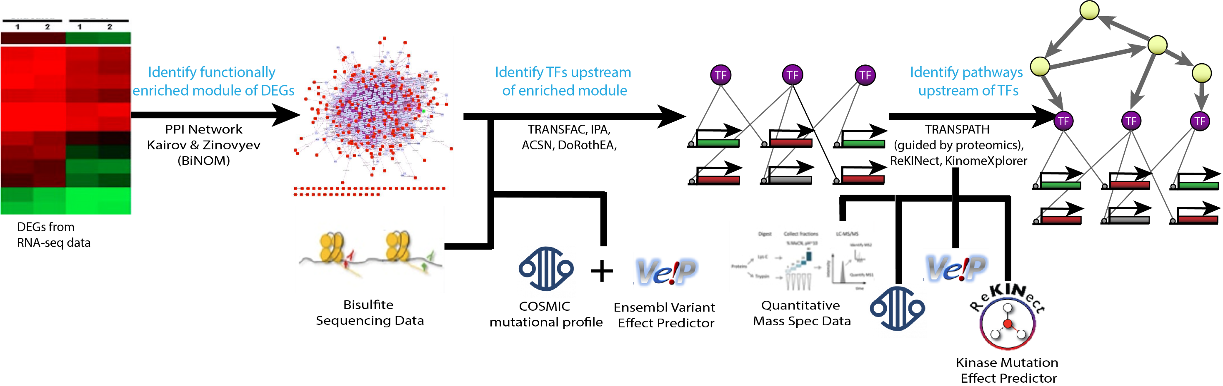
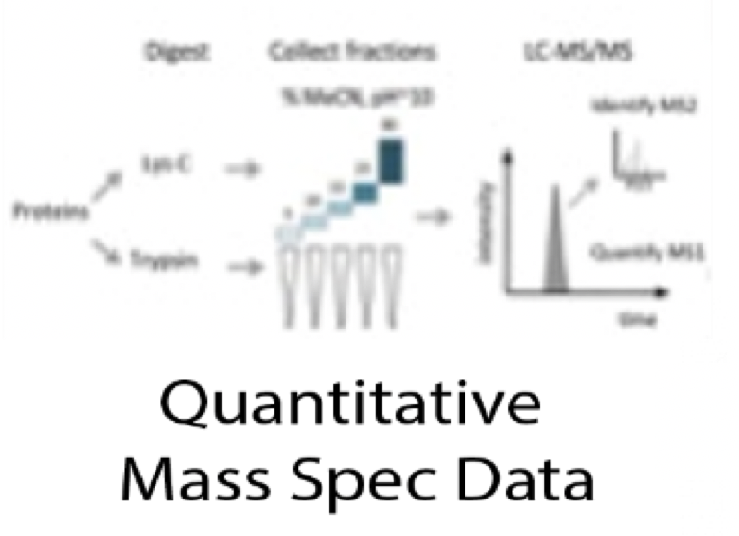




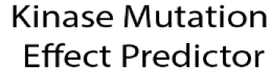
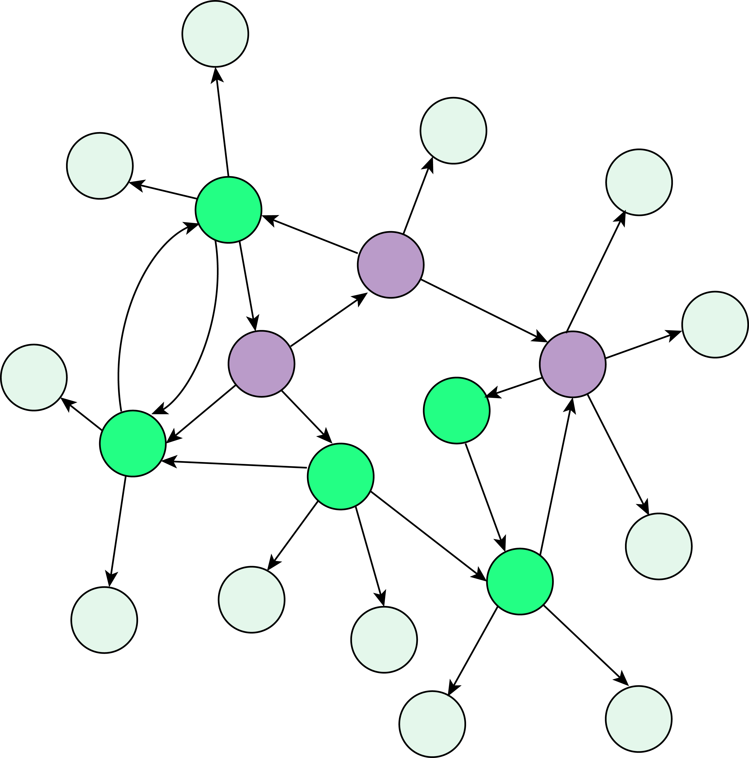
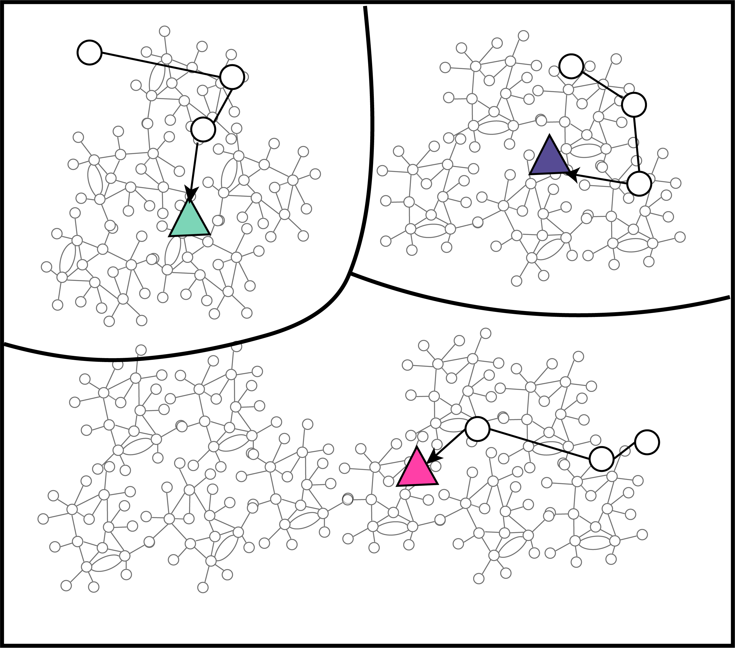
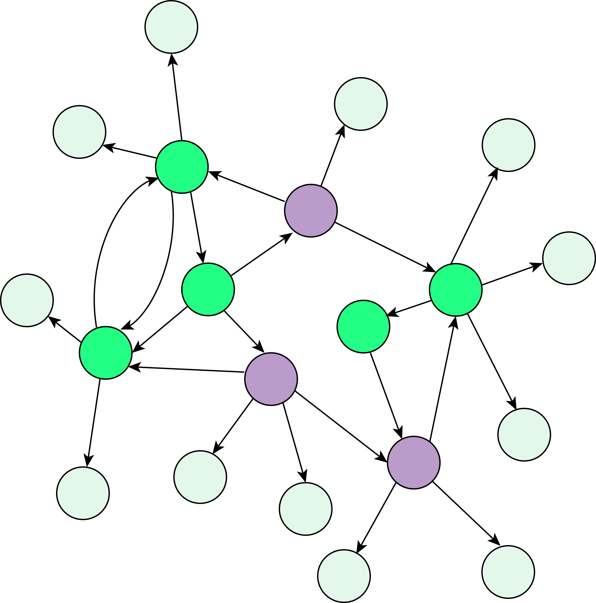
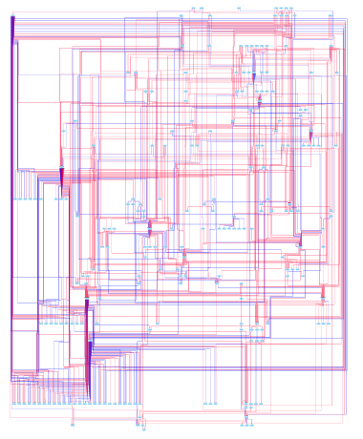
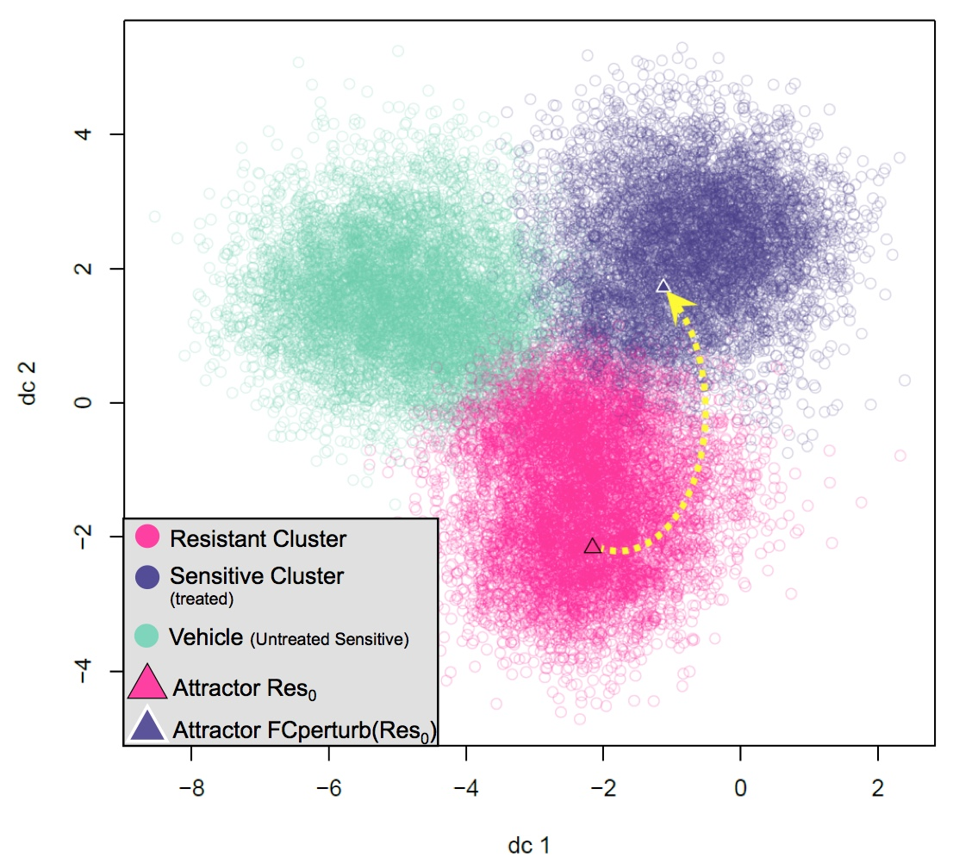
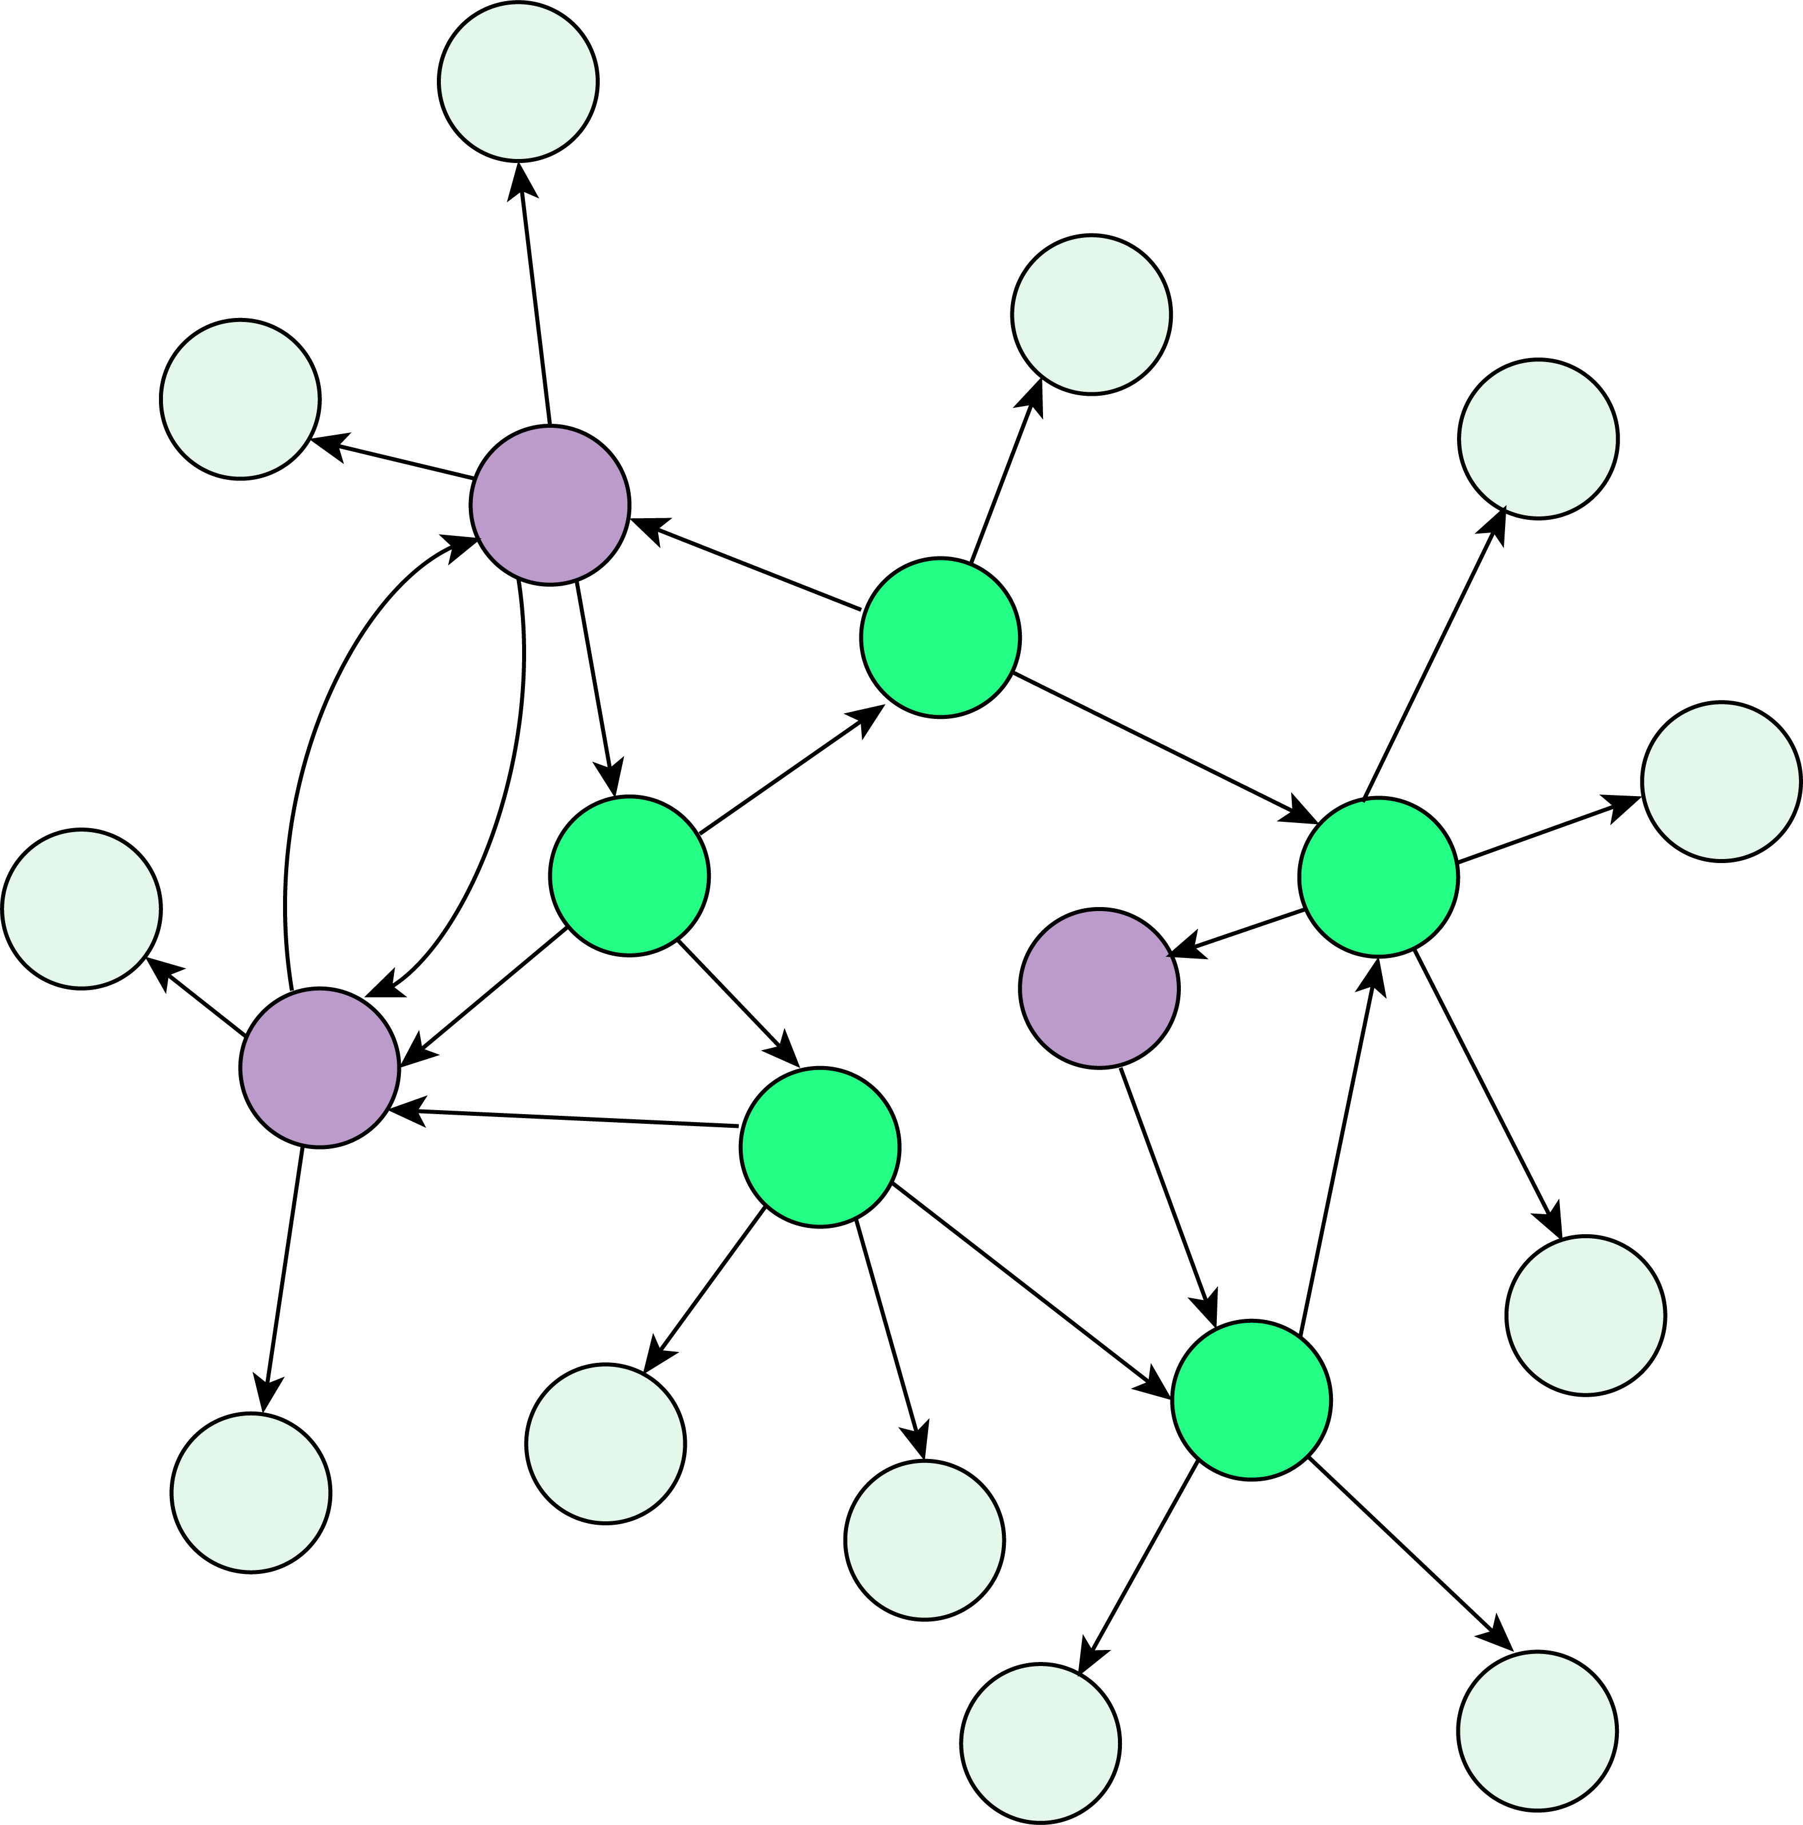
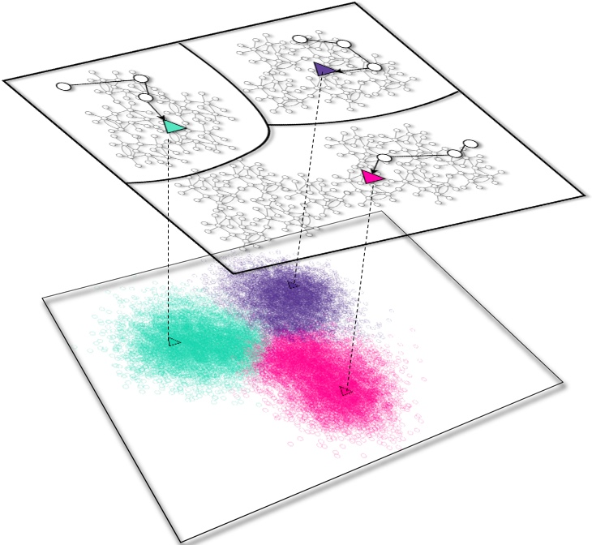
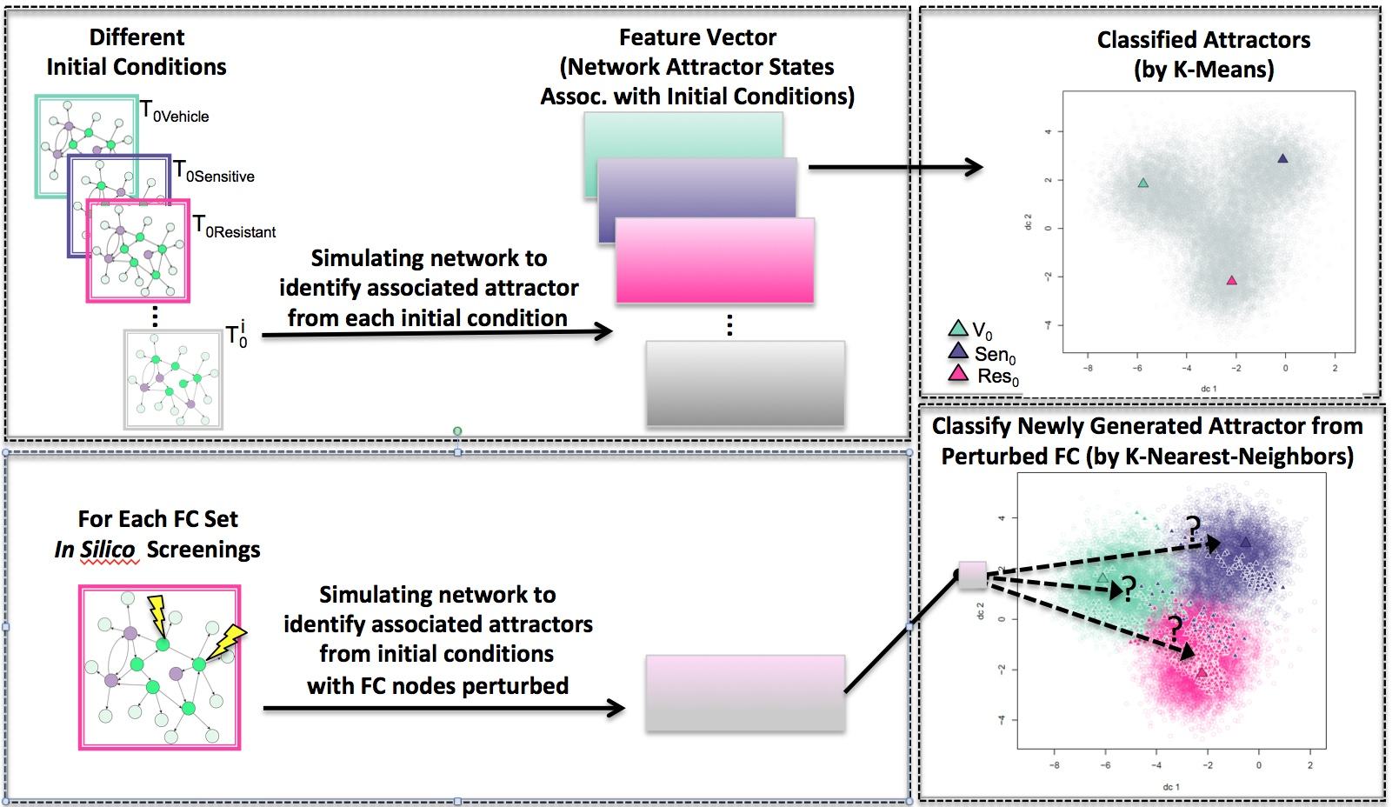
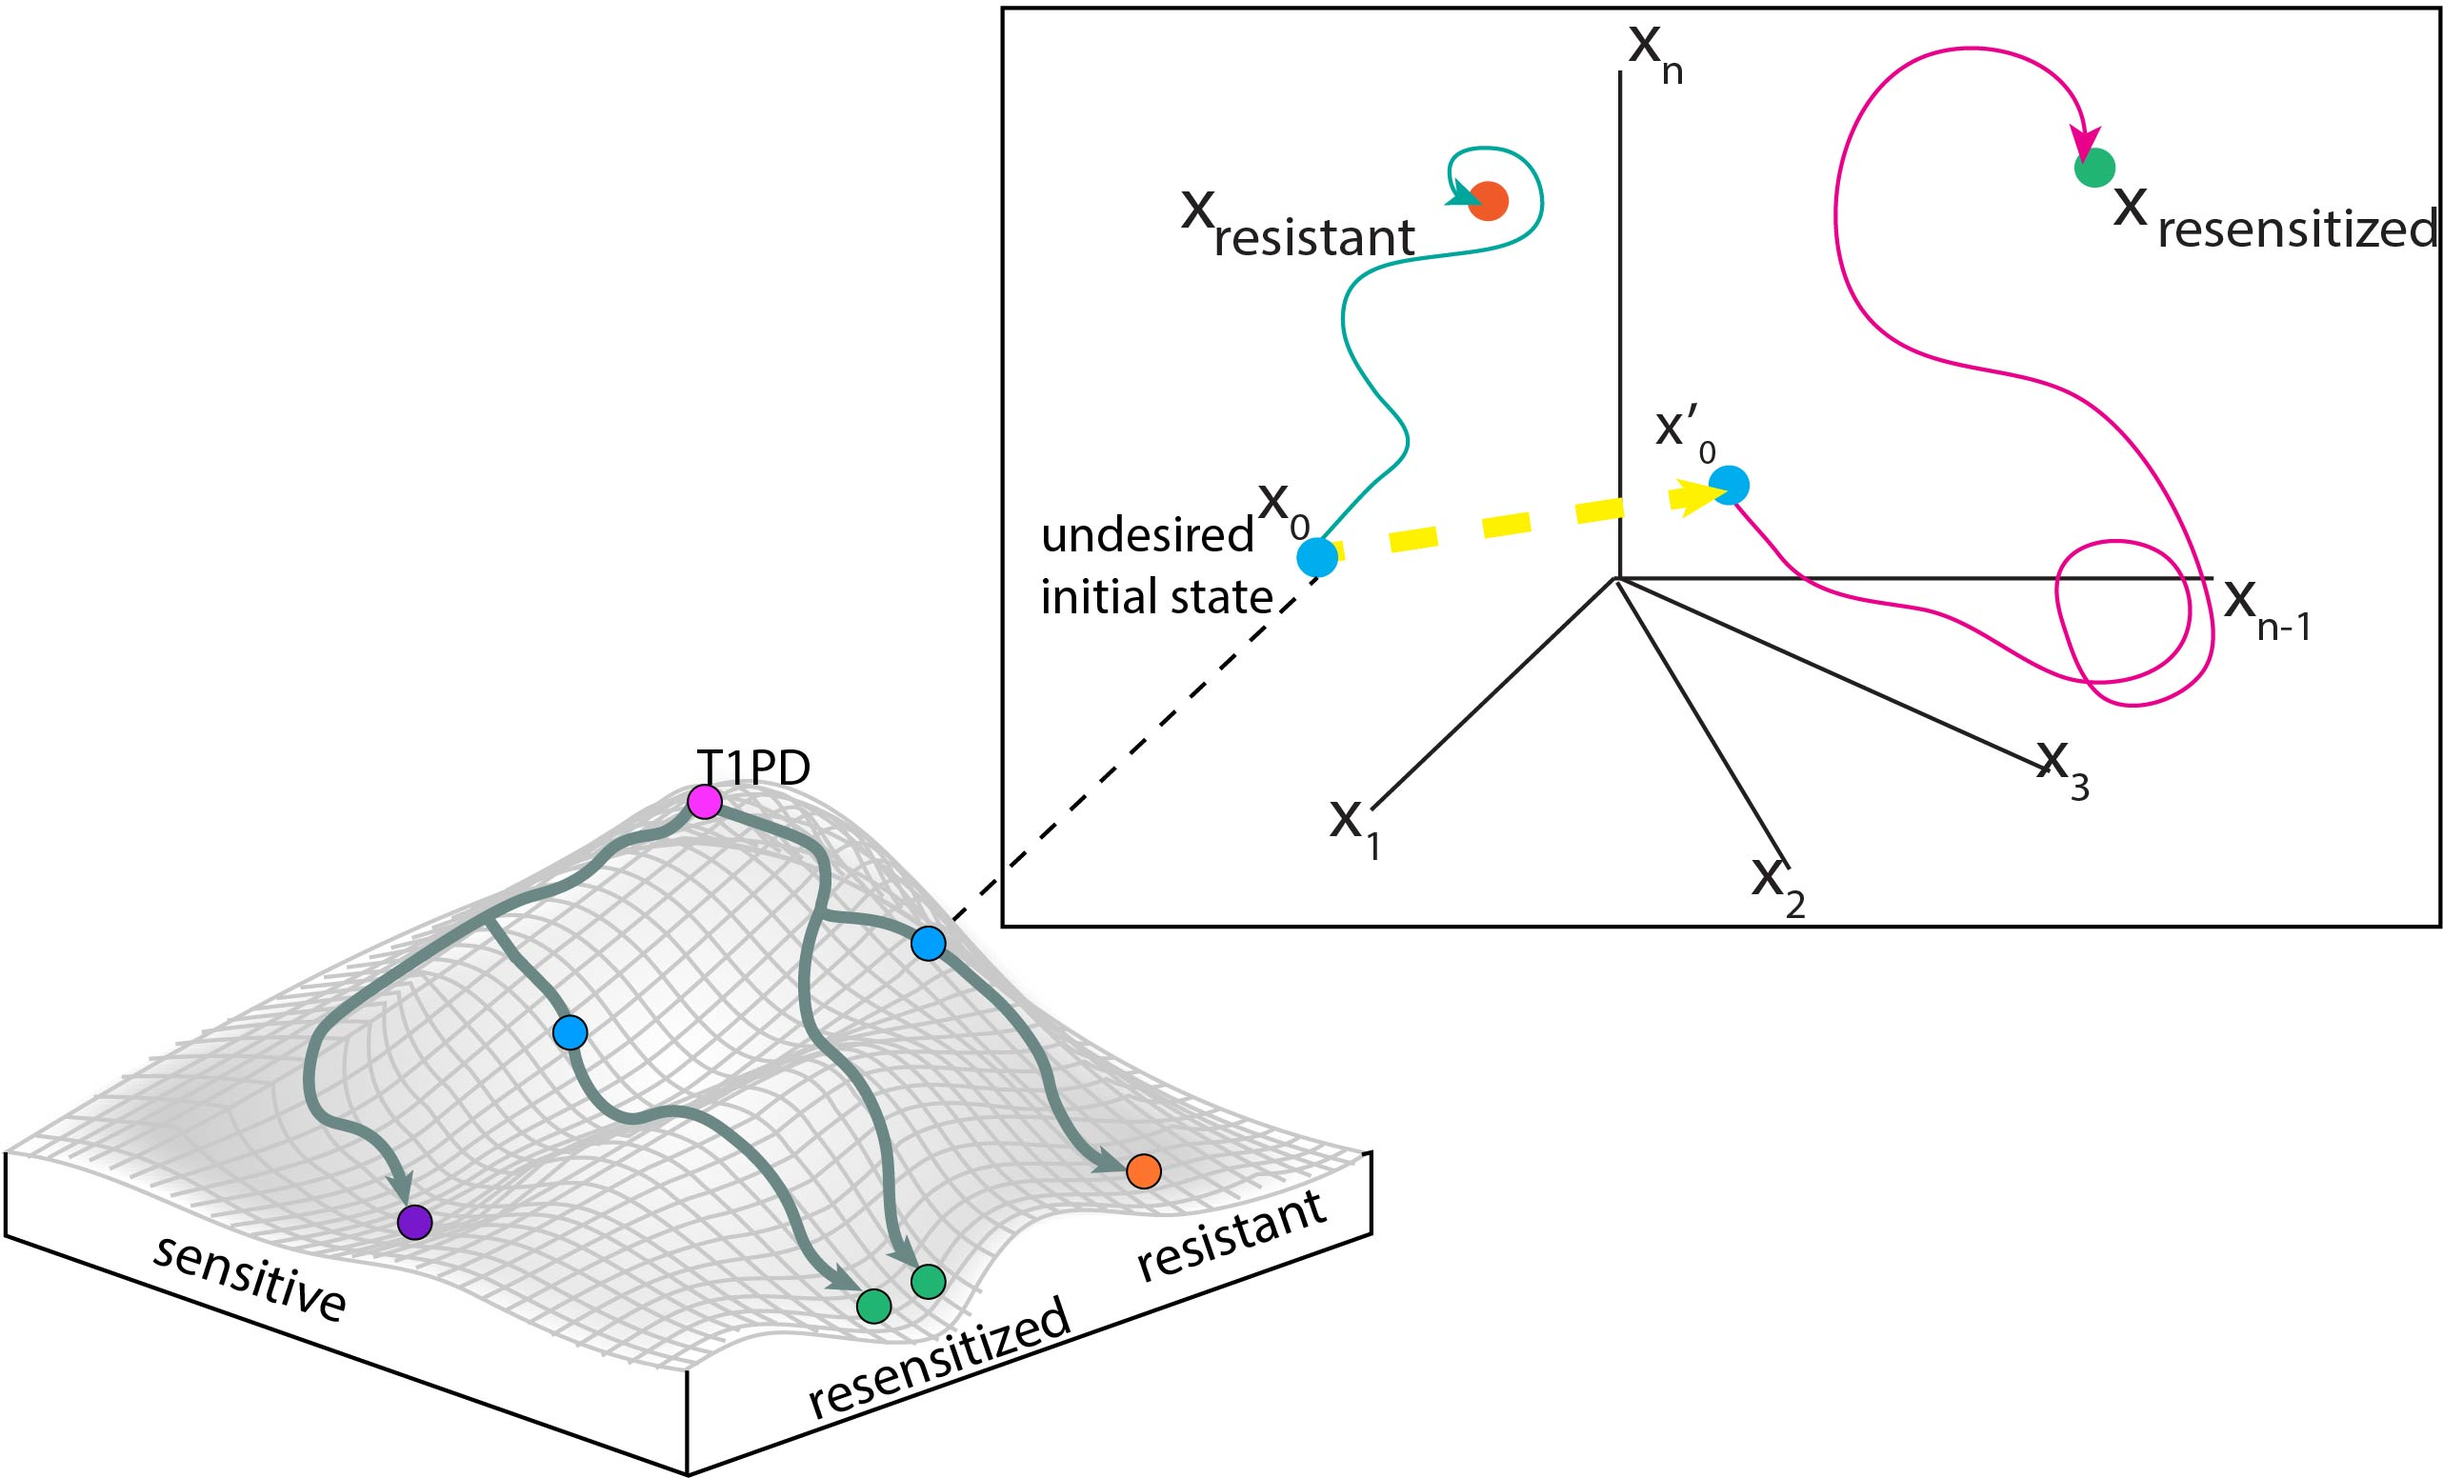
Identification of Combinations of Targets for Claudin-Low Triple Negative Breast Cancer Reversion
Madeleine S. Gastonguay¹, Lauren Marazzi¹, Paola Vera-Licona¹
Center for Quantitative Medicine, UConn Health, Farmington CT 06030
INTRODUCTION
METHODS
RESULTS
Triple Negative Breast Cancer (TNBC) is an aggressive, heterogenous subtype of breast cancer (BC) accounting for 20% of BC cases¹. Unlike other subtypes of BC which are characterized by the presence of estrogen receptors, progesterone receptors, or HER2 amplification, TNBC is characterized by the lack of all three of these markers. As a result, it is difficult to treat TNBC with current targeted therapies. Claudin-Low (CL) TNBC is a subtype of TNBC making up 7-14% of invasive breast cancers diagnoses². It is characterized by low expression of tight junction proteins Claudin 3, 4, and 7 and the cell adhesion molecule E-cadherin²⁻⁴. CL tumors are prone to epithelial to mesenchymal transition (EMT) as well as exhibiting stem-cell like characteristics, two hallmarks of cancer marking high metastasis rates^{2,5}. The low proliferation rate of the subtype sets it apart from most tumors, making it difficult to treat with cytotoxic drugs². CL TNBC has a poor prognosis and a clear need for new treatment options.
One potential therapeutic strategy is tumor reversion, the biological process by which tumor cells lose a significant fraction of their malignant phenotype⁷. Tumor reversion has been observed for over a century (SOURCE). It has also been achieved both in vitro, in vivo, and ex vivo. In particular, tumor reversion has been achieved in vitro with the CL cell line MDA-MB-231, and in vivo in a mice xenografted with MDA-MB-231 cells⁸⁻¹³.
At the cellular level, the development of cancer can be seen as a systems-level dynamical process driven by a tumorigenic intracellular signaling network. Attractors of this network correspond to cell phenotypes¹⁴. Cancer attractors are attractors presenting a malignant phenotype that are pre-existing in the network but not typically accessible and therefore not occupied by cells¹⁴. They can be accessed through genetic mutations or changes in the tumor microenvironment. Tumor reversion can be viewed as an optimal control problem in dynamical systems where the objective is to shift the system away from a cancerous attractor and towards normal-like attractors.
Structure-based control methods study the controllability of systems based solely on the structure of the network¹⁵⁻¹⁸. Attractor-based control methods focus on the controllability of the system by restricting the target states to attractors. Recently, structure-based attractor-based methods for non-linear systems have been proposed^{17,18}(Fig 1). The newly proposed Feedback Vertex Set Control (FC) framework is especially suited for systems with non-linear dynamics⁸. The objective of FC is to identify combinations of network nodes that drive the network from an arbitrary initial state to any desired dynamical attractor of the system through an override of their initial state.
Objectives: Develop and apply a computational systems biology pipeline for the construction and control of an intracellular signaling network of reversion of Claudin-Low Triple Negative Breast Cancer. The ultimate goal is to identify and experimentally validate combinations of therapeutic targets to aid in the reversion of CL TNBC.
STEP 1. Reconstruction of Tumorigenic Network. Multi-Omics Profiling data was used to identify functionally related differentially expressed genes (FunDEGs), their transcription factors (TFs), and the upstream molecules regulating FunDEGs and TFs.(Binom, rekinect, vep, transpath, transfac, acsn, ipa)
Claudin-Low TNBC Network. The constructed network has 230 nodes and 583 edges (Fig 6). 90 of the nodes are hallmarks of cancer, 27 are breast disease ontology associated, and 4 are claudin-low markers. 142 of the network nodes are in the ACSN. (SOURCES)
Attractor Landscape Estimation and Unsupervised Attractor Classification. We initialized the network with basal expression levels for MCF10A and MDA-MB-231, and ran SFA to estimate the corresponding attractors. We generated 100,000 random initial states of the system and simulated their corresponding attractors with SFA to estimate the attractor landscape of the network. All attractors were classified with K-Means with 10,000 initializations and optimal k of 6. The MCF10A and MDA-MB-231 attractors appeared in different clusters (Fig 7).
FC Control Analysis. We identified 6 FC sets in network. Each FC set contained 28 source nodes and 14 FVS nodes. We identified a subset of FVS nodes that were present in all 6 FC set. This FVS subset consists of 11 nodes: MAP2K6, MAP2K3, MAPK1, AURKA, CTNNB1, FOXM1, JUN, RELA, STAT3, TCF3, and AKT1. We applied all (3¹¹=177,147) perturbations on the FVS nodes parting from the cancerous state. INCLUDE KNN RESULTS
Figure 2. Pipeline for the Data-Driven Reconstruction of the Tumorigenic Signaling Network
Network nodes in arbitrary basal state
Other₀
Norm₀
Network nodes in basal state as normal
STEP 2. Estimating Attractor Landscape with Topological Signal Flow Analysis (SFA). We apply SFA¹⁹ to the network using 100,000 random initial conditions to estimate the attractor landscape based on the network topology (Fig 3)
Ca₀
Network nodes in basal state as cancerous
Norm₀
Figure 6. Tumorigenic Network. 230 nodes and 583 edges. Edges in red are activating edges, while blue edges are inhibitory.
Figure 7. Shifting Resistance Attractor Towards Sensitive Attractor. Applying the perturbations of FC₁ to the system, successfully shifted the resistant associated attractor Res₀ to sensitive associated attractor Fcperturb(Res₀). The classification of Fcperturb(Res₀) was done via KNN clustering with K=30
Figure 3. Attractor landscape including the associated attractors for the 2 conditions of interest: Cancerous (Ca) and Normal (Norm)
Other₀
Ca₀
An example of a combination of perturbations on the FVS subset that can shift from Resistant to the Sensitive Attractor is:
Downregulation: CREB1,CUX1, PAX5, TWIST1
Upregulation: RBPJ
TWIST1 has been shown to increase Cisplatin resistance²⁰. CREB1 is a member of CBP/ß-catenin/FOXM1 transcriptional complex and it was shown to be a molecular driver of TNBC²¹. CUX1 expression may lead to TNBC via repression of the estrogen receptor alpha²². Finally, inhibition of PAX5 increased cisplatin sensitivity in bladder cancer cells.
The Resistant associated attractors and the newly shifted Sensitive associated attractor are shown in Fig 8.
STEP 3. Estimating Phenotype Landscape with Unsupervised Machine Learning. We apply K-Means algorithm to cluster the simulated attractors (Fig 4).
FC₁={
}
Figure 1. Waddington’s Epigenetic Landscape and Optimal Control on State Space Portrait
Figure 4. Phenotype Landscape After Unsupervised Clustering.
STEP 4. Applying FC Control and In-Silico Screenings. We apply FC control⁸ to the network to identify control sets (FCs). We perform in-silico screenings using SFA and applied K-Nearest Neighbors (KNN) classifier to identify combinations of perturbations of nodes in each FC set that can shift attractors from the Tumorigenic to the Normal basin of attraction (Fig 5).
DISCUSSION
We have successfully constructed a pipeline for the reconstruction of the CL TNBC signaling network. Based on preliminary data, we were able to capture known TNBC dysregulated genes, ……… EMT, Stemness
Our in silico perturbation screenings did generate different Tumor Reversion Sets.
Future work includes the prioritize of FC sets to select few top sets for experimental validation. Finally, we plan to extend our analysis with dynamical modeling to compare results or possibly to obtain additional therapeutic targets.
DATA
Multi-Omics Profiling Data. To calculate differential gene expression, we have RNA-seq data for the CL TNBC cell line MDA-MB-231 and the normal breast cell line MCF10A¹⁹. We use bisulfite data and mass spectrometry data for MDA-MB-231 to consider the epigenetics and protein abundance of the tumor, respectively^{20,21}. Single Nucleotide Variation and Copy Number Variation profiles for MDA-MB-231 were taken from the Catalog of Somatic Mutations in Cancer (COSMIC)²².
Figure 5. Perturbation of FC sets and their Supervised Classification.

Slide 2
Identification of Combinations of Targets for Claudin-Low Triple Negative Breast Cancer Reversion
Madeleine S. Gastonguay¹, Lauren Marazzi¹, Paola Vera-Licona¹
Center for Quantitative Medicine, UConn Health, Farmington CT 06030
INTRODUCTION
METHODS
RESULTS
Triple Negative Breast Cancer (TNBC) is an aggressive, heterogenous subtype of breast cancer (BC) accounting for 20% of BC cases¹. Unlike other subtypes of BC which are characterized by the presence of estrogen receptors, progesterone receptors, or HER2 amplification, TNBC is characterized by the lack of all three of these markers. As a result, it is difficult to treat TNBC with current targeted therapies. Claudin-Low (CL) TNBC is a subtype of TNBC making up 7-14% of invasive breast cancers diagnoses^{2.} CL tumors are prone to epithelial to mesenchymal transition (EMT) and exhibiting stem-cell like characteristics, two hallmarks of cancer marking high metastasis rates^{2,5}. The low proliferation rate of the subtype sets it apart from most tumors, making it difficult to treat with cytotoxic drugs². CL TNBC tumors have a poor prognosis and a clear need for new treatment options.
Tumor reversion is the biological process by which tumor cells lose a significant fraction of their malignant phenotype⁷. Tumor reversion has been observed in vitro, in vivo, and ex vivo for over a century. In particular, tumor reversion has been achieved with the CL cell line MDA-MB-231 and in vivo in a mice xenografted with MDA-MB-231 cells⁸⁻¹³.
At the cellular level, the development of cancer can be seen as a systems-level dynamical process driven by a tumorigenic intracellular signaling network. Attractors of this network correspond to cell phenotypes¹⁴. Cancer attractors are attractors presenting a malignant phenotype that are pre-existing in the network but not typically accessible and therefore not occupied by cells¹⁴. They can be accessed through genetic mutations or changes in the tumor microenvironment. Tumor reversion can be viewed as an optimal control problem in dynamical systems where the objective is to shift the system away from a cancerous attractor and towards normal-like attractors.
Structure-based control methods study the controllability of systems based solely on the structure of the network¹⁵⁻¹⁸. Attractor-based control methods focus on the controllability of the system by restricting the target states to attractors. Recently, structure-based attractor-based control methods for non-linear systems have been proposed^{17,18}(Fig 1). The newly proposed Feedback Vertex Set Control (FC) framework is especially suited for systems with non-linear dynamics⁸. The objective of FC is to identify combinations of network nodes that drive the network from an arbitrary initial state to any desired dynamical attractor of the system through an override of their initial state.
Develop and apply a computational systems biology pipeline for the construction and control of an intracellular signaling network
Identify and experimentally validate combinations of therapeutic targets to aid in the reversion of Claudin-Low Triple Negative Breast Cancer
STEP 1. Reconstruction of Tumorigenic Network. Multi-Omics Profiling data was used to identify functionally related differentially expressed genes (FunDEGs), their transcription factors (TFs), and the upstream molecules regulating FunDEGs and TFs.(Binom, rekinect, vep, transpath, transfac, acsn, ipa)
Claudin-Low TNBC Network. The constructed network has 230 nodes and 583 edges (Fig 6). 90 of the nodes are hallmarks of cancer, 27 are breast disease ontology associated, and 4 are claudin-low markers. 142 of the network nodes are in the ACSN. (SOURCES)
Attractor Landscape Estimation and Unsupervised Attractor Classification. We initialized the network with basal expression levels for MCF10A and MDA-MB-231, and ran SFA to estimate the corresponding attractors. We generated 100,000 random initial states of the system and simulated their corresponding attractors with SFA to estimate the attractor landscape of the network. All attractors were classified with K-Means with 10,000 initializations and optimal k of 6. The MCF10A and MDA-MB-231 attractors appeared in different clusters (Fig 7).
FC Control Analysis. We identified 6 FC sets in network. Each FC set contained 28 source nodes and 14 FVS nodes. We identified a subset of FVS nodes that were present in all 6 FC set. This FVS subset consists of 11 nodes: MAP2K6, MAP2K3, MAPK1, AURKA, CTNNB1, FOXM1, JUN, RELA, STAT3, TCF3, and AKT1. We applied all (3¹¹=177,147) perturbations on the FVS nodes parting from the cancerous state. INCLUDE KNN RESULTS
Figure 2. Pipeline for the Data-Driven Reconstruction of the Tumorigenic Signaling Network
Norm₀
STEP 2. Estimating Attractor Landscape with Topological Signal Flow Analysis (SFA). We apply SFA¹⁹ to the network using 100,000 random initial conditions to estimate the attractor landscape based on the network topology (Fig 3)
Network nodes in arbitrary basal state
Other₀
Network nodes in basal state as normal
Figure 1. Waddington’s Epigenetic Landscape and Optimal Control on State Space Portrait
Ca₀
Network nodes in basal state as cancerous
Norm₀
Figure 6. Tumorigenic Network. 230 nodes and 583 edges. Edges in red are activating edges, while blue edges are inhibitory.
Figure 7. Shifting Resistance Attractor Towards Sensitive Attractor. Applying the perturbations of FC₁ to the system, successfully shifted the resistant associated attractor Res₀ to sensitive associated attractor Fcperturb(Res₀). The classification of Fcperturb(Res₀) was done via KNN clustering with K=30
Other₀
Ca₀
Figure 3. Attractor landscape including the associated attractors for the 2 conditions of interest: Cancerous (Ca) and Normal (Norm)
An example of a combination of perturbations on the FVS subset that can shift from Resistant to the Sensitive Attractor is:
Downregulation: CREB1,CUX1, PAX5, TWIST1
Upregulation: RBPJ
TWIST1 has been shown to increase Cisplatin resistance²⁰. CREB1 is a member of CBP/ß-catenin/FOXM1 transcriptional complex and it was shown to be a molecular driver of TNBC²¹. CUX1 expression may lead to TNBC via repression of the estrogen receptor alpha²². Finally, inhibition of PAX5 increased cisplatin sensitivity in bladder cancer cells.
The Resistant associated attractors and the newly shifted Sensitive associated attractor are shown in Fig 8.
STEP 3. Estimating Phenotype Landscape with Unsupervised Machine Learning. We apply K-Means algorithm to cluster the simulated attractors (Fig 4).
FC₁={
}
Figure 4. Phenotype Landscape After Unsupervised Clustering.
STEP 4. Applying FC Control and In-Silico Screenings. We apply FC control⁸ to the network to identify control sets (FCs). We perform in-silico screenings using SFA and applied K-Nearest Neighbors (KNN) classifier to identify combinations of perturbations of nodes in each FC set that can shift attractors from the Tumorigenic to the Normal basin of attraction (Fig 5).
DISCUSSION
Multi-Omics Profiling Dta. To calculate differential gene expression, we have RNA-seq data for the CL TNBC cell line MDA-MB-231 and the normal breast cell line MCF10A¹⁹. We use bisulfite data and mass spectrometry data for MDA-MB-231 to consider the epigenetics and protein abundance of the tumor, respectively^{20,21}. Single Nucleotide Variation and Copy Number Variation profiles for MDA-MB-231 were taken from the Catalog of Somatic Mutations in Cancer (COSMIC)²².
OBJECTIVES
We have successfully constructed a pipeline for the reconstruction of the CL TNBC signaling network. Based on preliminary data, we were able to capture known TNBC dysregulated genes, ……… EMT, Stemness
Our in silico perturbation screenings did generate different Tumor Reversion Sets.
Future work includes the prioritize of FC sets to select few top sets for experimental validation. Finally, we plan to extend our analysis with dynamical modeling to compare results or possibly to obtain additional therapeutic targets.
Figure 5. Perturbation of FC sets and their Supervised Classification.

Slide 3
Identification of Combinations of Targets for Claudin-Low Triple Negative Breast Cancer Reversion
Madeleine S. Gastonguay¹, Lauren Marazzi¹, Paola Vera-Licona¹
Center for Quantitative Medicine, UConn Health, Farmington CT 06030
INTRODUCTION
METHODS
RESULTS
Triple Negative Breast Cancer (TNBC) is an aggressive, heterogenous subtype of breast cancer (BC) accounting for 20% of BC cases¹. Unlike other subtypes of BC which are characterized by the presence of estrogen receptors, progesterone receptors, or HER2 amplification, TNBC is characterized by the lack of all three of these markers. As a result, it is difficult to treat TNBC with current targeted therapies. Claudin-Low (CL) TNBC is a subtype of TNBC making up 7-14% of invasive breast cancers diagnoses^{2.} CL tumors are prone to epithelial to mesenchymal transition (EMT) and exhibiting stem-cell like characteristics, two hallmarks of cancer marking high metastasis rates^{2,5}. The low proliferation rate of the subtype sets it apart from most tumors, making it difficult to treat with cytotoxic drugs². CL TNBC tumors have a poor prognosis and a clear need for new treatment options.
Tumor reversion: the biological process by which tumor cells lose a significant fraction of their malignant phenotype⁷.
Observed in vitro, in vivo, and ex vivo for over a century
Achieved with the CL cell line MDA-MB-231 and in vivo in a mice xenografted with MDA-MB-231 cells⁸⁻¹³.
At the cellular level, the development of cancer can be seen as a systems-level dynamical process driven by a tumorigenic intracellular signaling network. Attractors of this network correspond to cell phenotypes¹⁴. Cancer attractors are attractors presenting a malignant phenotype that are pre-existing in the network but not typically accessible and therefore not occupied by cells¹⁴. They can be accessed through genetic mutations or changes in the tumor microenvironment. Tumor reversion can be viewed as an optimal control problem in dynamical systems where the objective is to shift the system away from a cancerous attractor and towards normal-like attractors.
Structure-based control methods study the controllability of systems based solely on the structure of the network¹⁵⁻¹⁸. Attractor-based control methods focus on the controllability of the system by restricting the target states to attractors. Recently, structure-based attractor-based control methods for non-linear systems have been proposed^{17,18}(Fig 1). The newly proposed Feedback Vertex Set Control (FC) framework is especially suited for systems with non-linear dynamics⁸. The objective of FC is to identify combinations of network nodes that drive the network from an arbitrary initial state to any desired dynamical attractor of the system through an override of their initial state.
Objectives:
Develop and apply a computational systems biology pipeline for the construction and control of an intracellular signaling network
Identify and experimentally validate combinations of therapeutic targets to aid in the reversion of Claudin-Low Triple Negative Breast Cancer
STEP 1. Reconstruction of Tumorigenic Network. Multi-Omics Profiling data was used to identify functionally related differentially expressed genes (FunDEGs), their transcription factors (TFs), and the upstream molecules regulating FunDEGs and TFs.(Binom, rekinect, vep, transpath, transfac, acsn, ipa)
Claudin-Low TNBC Network. The constructed network has 230 nodes and 583 edges (Fig 6). 90 of the nodes are hallmarks of cancer, 27 are breast disease ontology associated, and 4 are claudin-low markers. 142 of the network nodes are in the ACSN. (SOURCES)
Attractor Landscape Estimation and Unsupervised Attractor Classification. We initialized the network with basal expression levels for MCF10A and MDA-MB-231, and ran SFA to estimate the corresponding attractors. We generated 100,000 random initial states of the system and simulated their corresponding attractors with SFA. All attractors were classified with K-Means using an optimal k of 6. The MCF10A and MDA-MB-231 attractors appeared in different clusters (Fig 7).
FC Control Analysis. We identified 6 FC sets in network. Each FC set contained 28 source nodes and 14 FVS nodes. We identified a subset of FVS nodes that were present in all 6 FC set. This FVS subset consists of 11 nodes: MAP2K6, MAP2K3, MAPK1, AURKA, CTNNB1, FOXM1, JUN, RELA, STAT3, TCF3, and AKT1. We applied all (3¹¹=177,147) perturbations on the FVS nodes parting from the cancerous state. INCLUDE KNN RESULTS
Figure 2. Pipeline for the Data-Driven Reconstruction of the Tumorigenic Signaling Network
Norm₀
STEP 2. Estimating Attractor Landscape with Topological Signal Flow Analysis (SFA). We apply SFA¹⁹ to the to estimate the attractor landscape based on the network topology (Fig 3)
Network nodes in arbitrary basal state
Other₀
Network nodes in basal state as normal
Ca₀
Network nodes in basal state as cancerous
Norm₀
Figure 6. Tumorigenic Network. 230 nodes and 583 edges. Edges in red are activating edges, while blue edges are inhibitory.
Figure 7. Shifting Resistance Attractor Towards Sensitive Attractor. Applying the perturbations of FC₁ to the system, successfully shifted the resistant associated attractor Res₀ to sensitive associated attractor Fcperturb(Res₀). The classification of Fcperturb(Res₀) was done via KNN clustering with K=30
Other₀
Ca₀
Figure 3. Attractor landscape including the associated attractors for the 2 conditions of interest: Cancerous (Ca) and Normal (Norm)
An example of a combination of perturbations on the FVS subset that can shift from Resistant to the Sensitive Attractor is:
Downregulation: CREB1,CUX1, PAX5, TWIST1
Upregulation: RBPJ
TWIST1 has been shown to increase Cisplatin resistance²⁰. CREB1 is a member of CBP/ß-catenin/FOXM1 transcriptional complex and it was shown to be a molecular driver of TNBC²¹. CUX1 expression may lead to TNBC via repression of the estrogen receptor alpha²². Finally, inhibition of PAX5 increased cisplatin sensitivity in bladder cancer cells.
The Resistant associated attractors and the newly shifted Sensitive associated attractor are shown in Fig 8.
STEP 3. Estimating Phenotype Landscape with Unsupervised Machine Learning. We apply K-Means algorithm to cluster the simulated attractors (Fig 4).
FC₁={
}
Figure 1. Waddington’s Epigenetic Landscape and Optimal Control on State Space Portrait
Figure 4. Phenotype Landscape After Unsupervised Clustering.
STEP 4. Applying FC Control and In-Silico Screenings. We apply FC control⁸ to the network to identify control sets (FCs). We perform in-silico screenings using SFA and applied K-Nearest Neighbors (KNN) classifier to identify combinations of perturbations of nodes in each FC set that can shift attractors from the Tumorigenic to the Normal basin of attraction (Fig 5).
DISCUSSION
We have successfully constructed a pipeline for the reconstruction of the CL TNBC signaling network. Based on preliminary data, we were able to capture known TNBC dysregulated genes, ……… EMT, Stemness
Our in silico perturbation screenings did generate different Tumor Reversion Sets.
Future work includes the prioritize of FC sets to select few top sets for experimental validation. Finally, we plan to extend our analysis with dynamical modeling to compare results or possibly to obtain additional therapeutic targets.
DATA
Multi-Omics Profiling Data. To calculate differential gene expression, we have RNA-seq data for the CL TNBC cell line MDA-MB-231 and the normal breast cell line MCF10A¹⁹. We use bisulfite data and mass spectrometry data for MDA-MB-231 to consider the epigenetics and protein abundance of the tumor, respectively^{20,21}. Single Nucleotide Variation and Copy Number Variation profiles for MDA-MB-231 were taken from the Catalog of Somatic Mutations in Cancer (COSMIC)²².
Figure 5. Perturbation of FC sets and their Supervised Classification.

Slide 4
Identification of Combinations of Targets for Claudin-Low Triple Negative Breast Cancer Reversion
Madeleine S. Gastonguay¹, Lauren Marazzi¹, Paola Vera-Licona¹
Center for Quantitative Medicine, UConn Health, Farmington CT 06030
INTRODUCTION
DATA
RESULTS Con’t
Triple Negative Breast Cancer (TNBC) is an aggressive, heterogenous subtype of breast cancer (BC) accounting for 20% of BC cases¹. Unlike other subtypes of BC which are characterized by the presence of estrogen receptors, progesterone receptors, or HER2 amplification, TNBC is characterized by the lack of all three of these markers. As a result, it is difficult to treat TNBC with current targeted therapies. Claudin-Low (CL) TNBC is a subtype of TNBC making up 7-14% of invasive breast cancers diagnoses². It is characterized by low expression of tight junction proteins Claudin 3, 4, and 7 and the cell adhesion molecule E-cadherin²⁻⁴. CL tumors are prone to epithelial to mesenchymal transition (EMT) as well as exhibiting stem-cell like characteristics, two hallmarks of cancer marking high metastasis rates^{2,5}. The low proliferation rate of the subtype sets it apart from most tumors, making it difficult to treat with cytotoxic drugs². CL TNBC has a poor prognosis and a clear need for new treatment options.
One potential therapeutic strategy is tumor reversion, the biological process by which tumor cells lose a significant fraction of their malignant phenotype⁷. Tumor reversion has been observed for over a century (SOURCE). It has also been achieved both in vitro, in vivo, and ex vivo. In particular, tumor reversion has been achieved in vitro with the CL cell line MDA-MB-231, and in vivo in a mice xenografted with MDA-MB-231 cells⁸⁻¹³.
At the cellular level, the development of cancer can be seen as a systems-level dynamical process driven by a tumorigenic intracellular signaling network. Attractors of this network correspond to cell phenotypes¹⁴. Cancer attractors are attractors presenting a malignant phenotype that are pre-existing in the network but not typically accessible and therefore not occupied by cells¹⁴. They can be accessed through genetic mutations or changes in the tumor microenvironment. Tumor reversion can be viewed as an optimal control problem in dynamical systems where the objective is to shift the system away from a cancerous attractor and towards normal-like attractors.
Structure-based control methods study the controllability of systems based solely on the structure of the network¹⁵⁻¹⁸. Attractor-based control methods focus on the controllability of the system by restricting the target states to attractors. Recently, structure-based attractor-based methods for non-linear systems have been proposed^{17,18}(Fig 1). The newly proposed Feedback Vertex Set Control (FC) framework is especially suited for systems with non-linear dynamics⁸. The objective of FC is to identify combinations of network nodes that drive the network from an arbitrary initial state to any desired dynamical attractor of the system through an override of their initial state.
Objectives: Develop and apply a computational systems biology pipeline for the construction and control of an intracellular signaling network of reversion of Claudin-Low Triple Negative Breast Cancer. The ultimate goal is to identify and experimentally validate combinations of therapeutic targets to aid in the reversion of CL TNBC.
Multi-Omics Profiling Data. To calculate differential gene expression, we have RNA-seq data for the CL TNBC cell line MDA-MB-231 and the normal breast cell line MCF10A¹⁹. We use bisulfite data and mass spectrometry data for MDA-MB-231 to consider the epigenetics and protein abundance of the tumor, respectively^{20,21}. Single Nucleotide Variation and Copy Number Variation profiles for MDA-MB-231 were taken from the Catalog of Somatic Mutations in Cancer (COSMIC)²².
METHODS
STEP 1. Reconstruction of Tumorigenic Network. Multi-Omics Profiling data was used to identify functionally related differentially expressed genes (FunDEGs), their transcription factors (TFs), and the upstream molecules regulating FunDEGs and TFs.(Binom, rekinect, vep, transpath, transfac, acsn, ipa)
Figure 6. Tumorigenic Network. 230 nodes and 583 edges. Edges in red are activating edges, while blue edges are inhibitory.
Figure 7. Shifting Resistance Attractor Towards Sensitive Attractor. Applying the perturbations of FC₁ to the system, successfully shifted the resistant associated attractor Res₀ to sensitive associated attractor Fcperturb(Res₀). The classification of Fcperturb(Res₀) was done via KNN clustering with K=30
Attractor Landscape Estimation and Unsupervised Attractor Classification. We initialized the network with basal expression levels for MCF10A and MDA-MB-231, and ran SFA to estimate the corresponding attractors. We generated 100,000 random initial states of the system and simulated their corresponding attractors with SFA to estimate the attractor landscape of the network. All attractors were classified with K-Means (nstart = 1000. The MCF10A and MDA-MB-231 attractors appeared in different clusters (Fig).
FC Control Analysis. We identified 6 FC sets in network. Each FC set contained 28 source nodes and 14 FVS nodes. We identified a subset of FVS nodes that were present in all 6 FC set. This FVS subset consists of 11 nodes: MAP2K6, MAP2K3, MAPK1, AURKA, CTNNB1, FOXM1, JUN, RELA, STAT3, TCF3, and AKT1. We applied all (3¹¹=177,147) perturbations on the FVS nodes parting from the cancerous state. INCLUDE KNN RESULTS
Claudin-Low TNBC Network. The constructed network has 230 nodes and 583 edges (Fig ). 90 of the nodes are hallmarks of cancer, 27 are breast disease ontology associated, and 4 are claudin-low markers. 142 of the network nodes are in the ACSN. (SOURCES)
Attractor Landscape Estimation and Unsupervised Attractor Classification. We initialized the network with basal expression levels for MCF10A and MDA-MB-231, and ran SFA to estimate the corresponding attractors. We generated 100,000 random initial states of the system and simulated their corresponding attractors with SFA to estimate the attractor landscape of the network. All attractors were classified with K-Means with 10,000 initializations and optimal k of 6. The MCF10A and MDA-MB-231 attractors appeared in different clusters (Fig 7).
Figure 2. Pipeline for the Data-Driven Reconstruction of the Tumorigenic Signaling Network
STEP 2. Estimating Attractor Landscape with Topological Signal Flow Analysis (SFA). We apply SFA¹⁹ to the network using 100,000 random initial conditions to estimate the attractor landscape based on the network topology (Fig 3).
STEP 3. Estimating Phenotype Landscape with Unsupervised Machine Learning. We apply K-Means algorithm to cluster the simulated attractors (Fig 4).
STEP 4. Applying FC Control and In-Silico Screenings. We apply FC control⁸ to the network to identify control sets (FCs). We perform in-silico screenings and applied K-Nearest Neighbors (KNN) classifier to identify combinations of perturbations of nodes in each FC set that can shift attractors from the Tumorigenic to the Normal basin of attraction (Fig 5).
Network nodes in arbitrary basal state
Other₀
Norm₀
Network nodes in basal state as normal
Ca₀
Network nodes in basal state as cancerous
Figure 3. Attractor landscape including the associated attractors for the 2 conditions of interest: Cancerous (Ca) and Normal (Norm)
Other₀
Norm₀
An example of a combination of perturbations on the FVS subset that can shift from Resistant to the Sensitive Attractor is:
Downregulation: CREB1,CUX1, PAX5, TWIST1
Upregulation: RBPJ
TWIST1 has been shown to increase Cisplatin resistance²⁰. CREB1 is a member of CBP/ß-catenin/FOXM1 transcriptional complex and it was shown to be a molecular driver of TNBC²¹. CUX1 expression may lead to TNBC via repression of the estrogen receptor alpha²². Finally, inhibition of PAX5 increased cisplatin sensitivity in bladder cancer cells.
The Resistant associated attractors and the newly shifted Sensitive associated attractor are shown in Fig 8.
Ca₀
FC₁={
}
Figure 1. Waddington’s Epigenetic Landscape and Optimal Control on State Space Portrait
Figure 4. Phenotype Landscape After Unsupervised Clustering.
Figure 5. Perturbation of FC sets and their Supervised Classification.
RESULTS
DISCUSSION
We have successfully constructed a pipeline for the reconstruction of the CL TNBC signaling network. Based on preliminary data, we were able to capture known CL TNBC dysregulated genes, as well as genes related to EMT and Stemness.
Our in silico perturbation screenings did generate different Tumor Reversion Sets.
Future work includes the prioritize of FC sets to select few top sets for experimental validation. Finally, we plan to extend our analysis with dynamical modeling to compare results or possibly to obtain additional therapeutic targets.

Slide 5
Identification of Combinations of Targets for Claudin-Low Triple Negative Breast Cancer Reversion
Madeleine S. Gastonguay¹, Lauren Marazzi¹, Paola Vera-Licona¹
Center for Quantitative Medicine, UConn Health, Farmington CT 06030
INTRODUCTION
DATA
RESULTS Con’t
Triple Negative Breast Cancer (TNBC) is an aggressive, heterogenous subtype of breast cancer (BC) accounting for 20% of BC cases¹. Unlike other subtypes of BC which are characterized by the presence of estrogen receptors, progesterone receptors, or HER2 amplification, TNBC is characterized by the lack of all three of these markers. As a result, it is difficult to treat TNBC with current targeted therapies. Claudin-Low (CL) TNBC is a subtype of TNBC making up 7-14% of invasive breast cancers diagnoses². It is characterized by low expression of tight junction proteins Claudin 3, 4, and 7 and the cell adhesion molecule E-cadherin²⁻⁴. CL tumors are prone to epithelial to mesenchymal transition (EMT) as well as exhibiting stem-cell like characteristics, two hallmarks of cancer marking high metastasis rates^{2,5}. The low proliferation rate of the subtype sets it apart from most tumors, making it difficult to treat with cytotoxic drugs². CL TNBC has a poor prognosis and a clear need for new treatment options.
One potential therapeutic strategy is tumor reversion, the biological process by which tumor cells lose a significant fraction of their malignant phenotype⁷. Tumor reversion has been observed for over a century (SOURCE). It has also been achieved both in vitro, in vivo, and ex vivo. In particular, tumor reversion has been achieved in vitro with the CL cell line MDA-MB-231, and in vivo in a mice xenografted with MDA-MB-231 cells⁸⁻¹³.
At the cellular level, the development of cancer can be seen as a systems-level dynamical process driven by a tumorigenic intracellular signaling network. Attractors of this network correspond to cell phenotypes¹⁴. Cancer attractors are attractors presenting a malignant phenotype that are pre-existing in the network but not typically accessible and therefore not occupied by cells¹⁴. They can be accessed through genetic mutations or changes in the tumor microenvironment. Tumor reversion can be viewed as an optimal control problem in dynamical systems where the objective is to shift the system away from a cancerous attractor and towards normal-like attractors.
Structure-based control methods study the controllability of systems based solely on the structure of the network¹⁵⁻¹⁸. Attractor-based control methods focus on the controllability of the system by restricting the target states to attractors. Recently, structure-based attractor-based methods for non-linear systems have been proposed^{17,18}(Fig 1). The newly proposed Feedback Vertex Set Control (FC) framework is especially suited for systems with non-linear dynamics⁸. The objective of FC is to identify combinations of network nodes that drive the network from an arbitrary initial state to any desired dynamical attractor of the system through an override of their initial state.
Objectives: Develop and apply a computational systems biology pipeline for the construction and control of an intracellular signaling network of reversion of Claudin-Low Triple Negative Breast Cancer. The ultimate goal is to identify and experimentally validate combinations of therapeutic targets to aid in the reversion of CL TNBC.
Multi-Omics Profiling Data. To calculate differential gene expression, we have RNA-seq data for the CL TNBC cell line MDA-MB-231 and the normal breast cell line MCF10A¹⁹. We use bisulfite data and mass spectrometry data for MDA-MB-231 to consider the epigenetics and protein abundance of the tumor, respectively^{20,21}. Single Nucleotide Variation and Copy Number Variation profiles for MDA-MB-231 were taken from the Catalog of Somatic Mutations in Cancer (COSMIC)²².
METHODS
STEP 1. Reconstruction of Tumorigenic Network. Multi-Omics Profiling data was used to identify functionally related differentially expressed genes (FunDEGs), their transcription factors (TFs), and the upstream molecules regulating FunDEGs and TFs.(Binom, rekinect, vep, transpath, transfac, acsn, ipa)
Figure 6. Tumorigenic Network. 230 nodes and 583 edges. Edges in red are activating edges, while blue edges are inhibitory.
Figure 7. Shifting Resistance Attractor Towards Sensitive Attractor. Applying the perturbations of FC₁ to the system, successfully shifted the resistant associated attractor Res₀ to sensitive associated attractor Fcperturb(Res₀). The classification of Fcperturb(Res₀) was done via KNN clustering with K=30
Figure 2. Pipeline for the Data-Driven Reconstruction of the Tumorigenic Signaling Network
STEP 2. Estimating Attractor Landscape with Topological Signal Flow Analysis (SFA). We apply SFA¹⁹ to the network using 100,000 random initial conditions to estimate the attractor landscape based on the network topology (Fig 3).
STEP 3. Estimating Phenotype Landscape with Unsupervised Machine Learning. We apply K-Means algorithm to cluster the simulated attractors (Fig 4).
STEP 4. Applying FC Control and In-Silico Screenings. We apply FC control⁸ to the network to identify control sets (FCs). We perform in-silico screenings and applied K-Nearest Neighbors (KNN) classifier to identify combinations of perturbations of nodes in each FC set that can shift attractors from the Tumorigenic to the Normal basin of attraction (Fig 5).
Network nodes in arbitrary basal state
Other₀
Norm₀
Network nodes in basal state as normal
Ca₀
Network nodes in basal state as cancerous
Figure 3. Attractor landscape including the associated attractors for the 2 conditions of interest: Cancerous (Ca) and Normal (Norm)
An example of a combination of perturbations on the FVS subset that can shift from Resistant to the Sensitive Attractor is:
Downregulation: CREB1,CUX1, PAX5, TWIST1
Upregulation: RBPJ
TWIST1 has been shown to increase Cisplatin resistance²⁰. CREB1 is a member of CBP/ß-catenin/FOXM1 transcriptional complex and it was shown to be a molecular driver of TNBC²¹. CUX1 expression may lead to TNBC via repression of the estrogen receptor alpha²². Finally, inhibition of PAX5 increased cisplatin sensitivity in bladder cancer cells.
The Resistant associated attractors and the newly shifted Sensitive associated attractor are shown in Fig 8.
FC₁={
}
Figure 1. Waddington’s Epigenetic Landscape and Optimal Control on State Space Portrait
Norm₀
Other₀
Ca₀
DISCUSSION
We have successfully constructed a pipeline for the reconstruction of the CL TNBC signaling network. Based on preliminary data, we were able to capture known CL TNBC dysregulated genes, as well as genes related to EMT and Stemness.
Our in silico perturbation screenings did generate different Tumor Reversion Sets.
Future work includes the prioritize of FC sets to select few top sets for experimental validation. Finally, we plan to extend our analysis with dynamical modeling to compare results or possibly to obtain additional therapeutic targets.
Figure 4. Phenotype Landscape After Unsupervised Clustering.
Figure 5. Perturbation of FC sets and their Supervised Classification.

